Slide 1


MARKETING
ANALYTICS
GROUP 4
JIBIN SEBASTIAN
JIBIN GEORGE
KAILAS KRISHNAN
VISHAL RAMESH BABU
YASHAS MYSORE SRIHARI

Slide 2

Customer Churn Analysis for
E-commerce Site

Slide 3




PROJECT OVERVIEW
Objective: To analyze the customer base, identify characteristics of churn, and predict future churn to devise strategies for customer retention.
Key Goals:
Perform customer churn analysis.
Develop predictive models using Decision Tree, Random Forest and Logistic Regression.
Devise marketing strategies for retention.

Slide 4
Data Cleaning
The data cleaning process for categorical data involves identifying and standardizing entries to ensure consistency. Initially, unique values in each categorical column are printed for inspection. The values are then converted to lowercase, and spaces are replaced with underscores to maintain uniformity. Duplicates are addressed by mapping similar entries to a single standardized term, such as replacing "Phone" with "mobile_phone" and "CC" with "credit_card."

Slide 5
Data Cleaning
After standardizing the categorical data, the next step is to verify that all replacements were successful by reprinting the unique values to ensure that the cleaning process has been effective and that no inconsistencies remain in the dataset for further analysis

Slide 6
Data Cleaning
For numerical data, missing values are imputed using the KNN Imputer.
Before imputation, categorical variables are converted to numerical form using one-hot encoding. The KNN Imputer is then applied to fill in missing values based on the nearest neighbors' approach. The imputed data is converted back into a DataFrame, replacing the original columns with these newly imputed values, ensuring a complete and clean dataset for analysis.

Slide 7
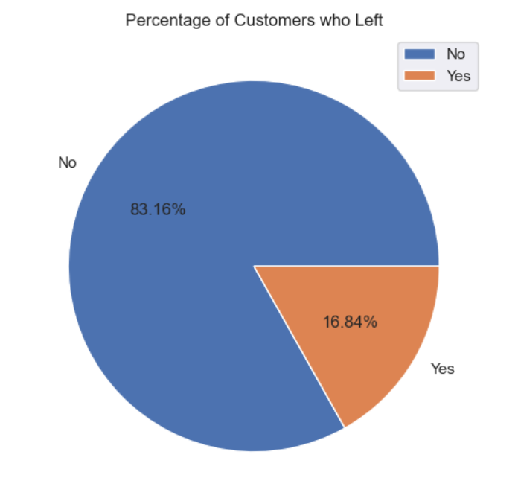
Exploratory Data Analysis (EDA)
Percentage of Customers who left
16.84% of customers churned

Slide 8
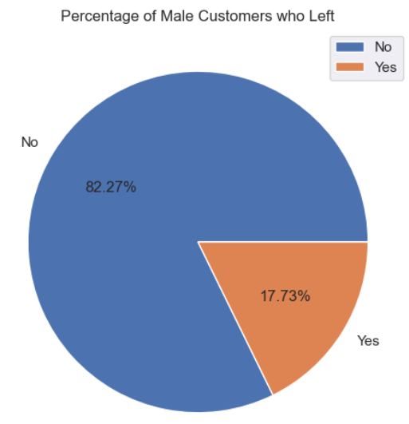
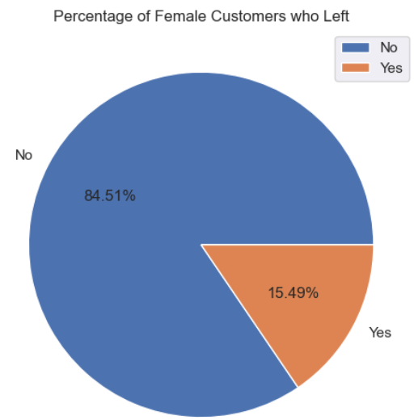
Customer Churn by Gender
Gender has no effect on churn since the percentage of males and females who left the company is almost same.

Slide 9
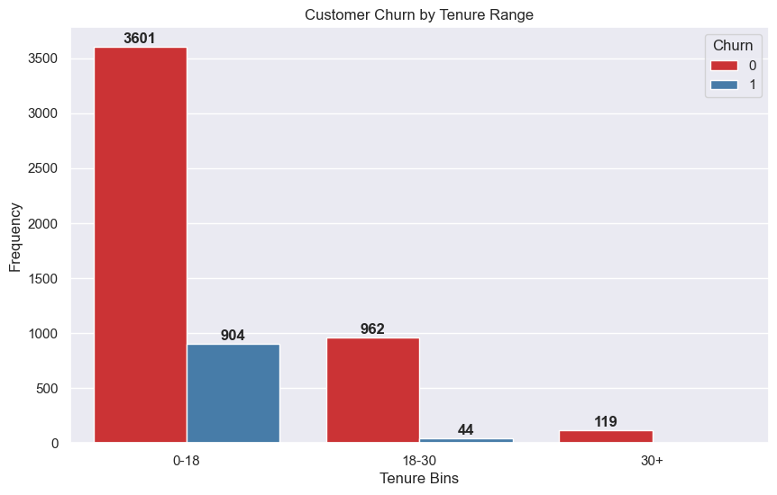
Customer Churn by Tenure Range
Most customers churned in the first 18 months may be due to the first impressions from the company.
Long term customers tend to stay longer may be due to the service provided by the company.
This indicates that the company should focus on giving more priority to new customers.

Slide 10
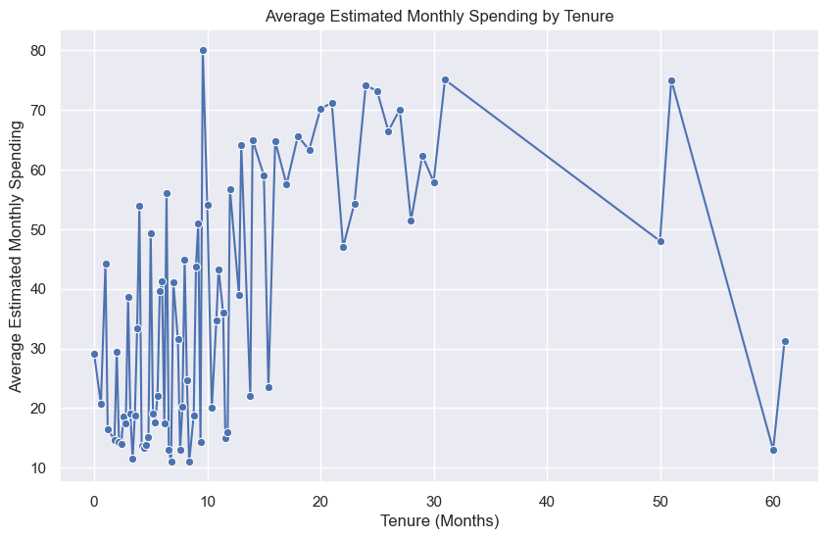
Average Estimated Monthly Spending by Tenure
The graph shows that the estimated monthly spending doesn't have any impact on tenure.

Slide 11
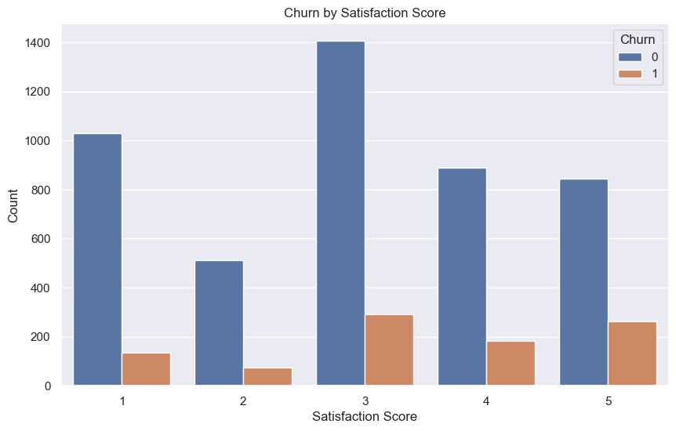
Churn by Satisfaction Score
Satisfaction Score has no effect on customer Churn since the percentage of churned customers is similar by comparing bar heights.

Slide 12
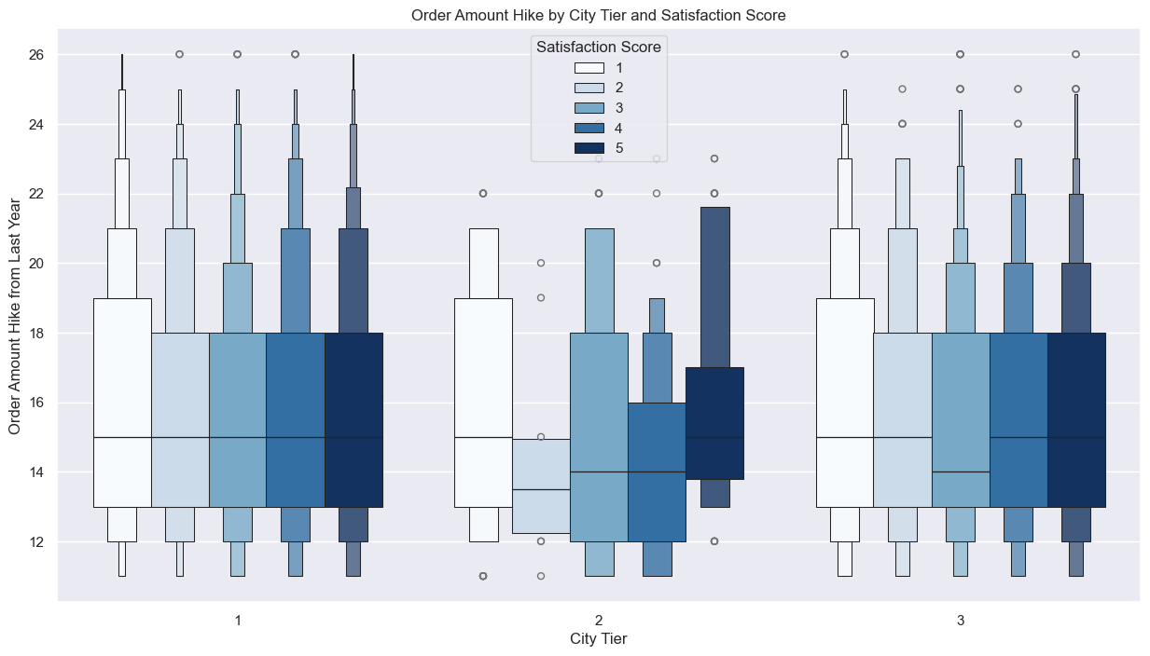
Order Amount Hike by City Tier and Satisfaction Score
The order amount hike is equally distributed for all satisfaction scores for cities 1 and 3.
In tier 2 cities people with low satisfaction scores tend to have a lower order amount hike compared to people with good satisfaction scores.
This implies that the company could concentrate on customers in city tier 2 by giving more offers and discounts.

Slide 13
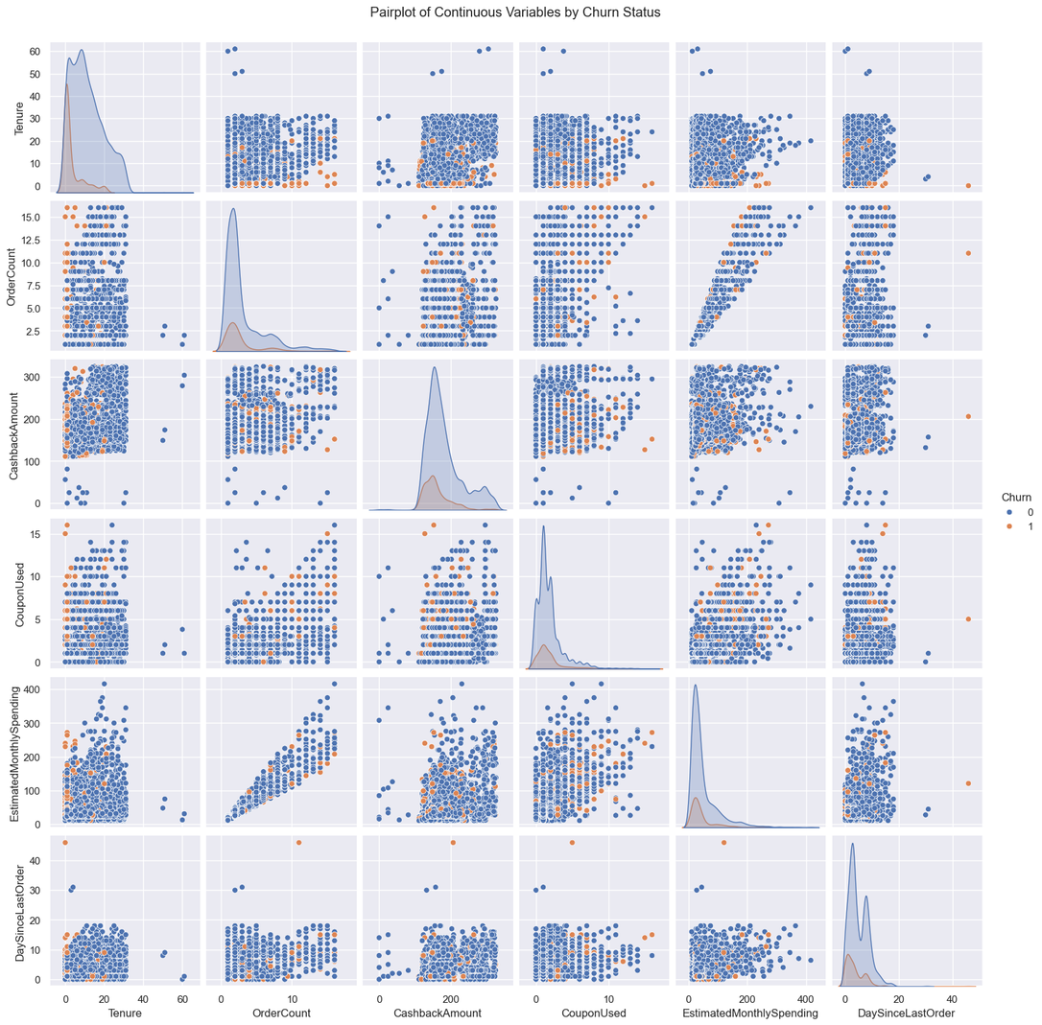
Pairplot of Continuous Variables by Churn Status
CouponUsed and OrderCount have a better correlation than any other features in the original data which doesn't provide any insights.
Rest all features have a very lower correlation score with other variables.
The made up column EstimatedMonthlySpending have a better correlation with all other variables in the dataset.

Slide 14
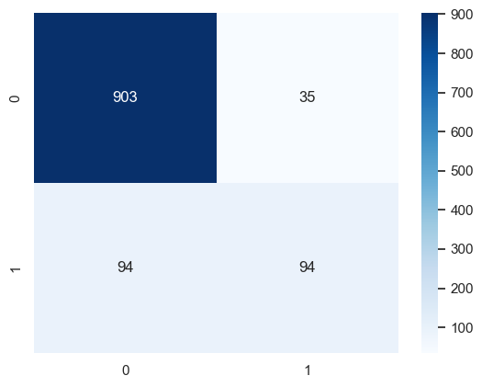
Modelling
Logistic Regression
Accuracy : 0.89

Slide 15
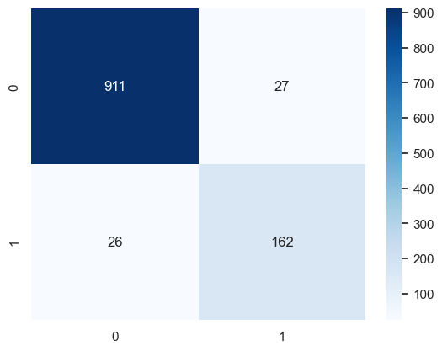
Modelling
Decision Tree
Accuracy : 0.95

Slide 16
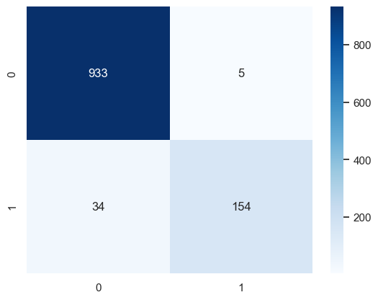
Modelling
Random Forest
Accuracy : 0.97

Slide 17
Marketing Strategies
During our analysis we found that most customers are leaving at the first few months of the service tenure. These customers churned maybe because they found a better alterntive to what the company was already offering. A better understanding of the competitora as well as providing attractive offers to new customers can be a way to improve retention.
Actively seeking feedback from customers who leave early as well as concentrating on providing flexible plans to cities where the customer satisfaction scores are low can be also implemented to reduce churn.
Implementing regular follow-up to customers who recently joined can improve their perspective of the company as well as motivate them to refer others.

Slide 18

THANK YOU

